Slide 1
13- Stacks

Slide 2
context
Last In – First Out (LIFO) 3
use a list object as a stack 4
Ex.1 5
Ex.2 6

Slide 3

Last In – First Out (LIFO)

Slide 4

use a list object as a stack

Slide 5
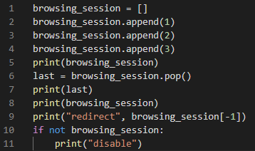

Ex.1

Slide 6

Ex.2

